Slide 1

#LifeKoKaroLift
Post-Graduate Diploma in ML/AI

Slide 2



Course : Machine Learning
Lecture On : Pre exam session
Instructor : Manish Kumar

Slide 3
Modules Included
Statistics Essentials
Inferential Statistics
Hypothesis Testing
Exploratory Data Analysis
Python

Slide 4
Modules Included
ML - 1
Linear Regression
Logistic Regression
Naïve Bayes
Model Selection

Slide 5
INFERENTIAL STATISTICS
Expected Value
The expected value for a variable X is the value of X we would “expect” to get after performing the experiment once. It is also called the expectation, average, and mean value
Discrete Probability Distributions
Continuous Probability Distributions
A discrete distribution describes the probability of occurrence of each value of a discrete random variable. A discrete random variable is a random variable that has countable values, such as a list of non-negative integers. Ex. A coin flip
A continuous distribution describes the probabilities of the possible values of a continuous random variable. A continuous random variable is a random variable with a set of possible values (known as the range) that is infinite and uncountable Ex. Commute time of an upgrad employee

Slide 6



Descriptive Statistics
“ A descriptive statistic is a summary statistic that quantitatively describes or summarizes features of a collection of information. “
Measurement level of Data
Cardinal Numbers
A Cardinal Number says how many of something there are, such as one, two, three ..
It answers the question "How Many?“ , Example: here are five coins
Ordinal Numbers
An Ordinal Number tells us the position of something in a list.1st, 2nd, 3rd, 4th, 5th and so on, eg: Grades, Star Reviews, Position in Race, Date
Nominal Numbers
A Nominal Number is a number used only as a name, or to identify something (not as an actual value or position) eg: Brand Name, ZipCode, Gender
Notes:
It is used to describe the characteristics of data in short it helps us in knowing our data better.

Slide 7
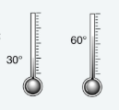
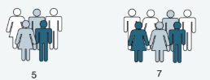
Measurement level of Data
Interval: Data at this level can be ordered as it is in a range of values and meaningful differences between the data points can be calculated. eg: Temperature in Celsius, Year of Birth
Temperature In degree & Fahrenheit
Ratio: Data at this level is similar to interval level with added property of an inherent zero. Mathematical calculations can be performed on these data points. eg: Height, Age, Weight

Slide 8
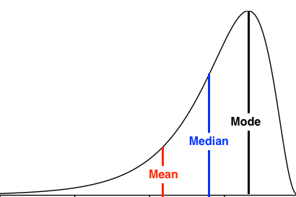
Measures of Central Tendency
“ The measure of central tendency is a single value that attempts to describe a set of data by identifying the central position within that set of data.”
Notes:
Mean : It susceptible to outliers when unusual values are added it gets skewed i.e. deviates from the typical central value.
Median : better alternative to mean as it is less affected by outliers and skewness of the data.
Mode: The mode is the most commonly occurring value in the dataset. The mode can, therefore sometimes consider the mode as being the most popular option.

Slide 9



Poll
If a positively skewed distribution has a median of 50, which of the following statement is true?
A) Mean is greater than 50 B) Mean is less than 50 C) Mode is less than 50 D) Mode is greater than 50 E) Both A and C F) Both B and D
24-10-2020
11

Slide 10
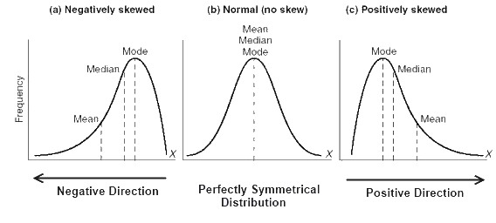
Poll
If a positively skewed distribution has a median of 50, which of the following statement is true?
A) Mean is greater than 50 B) Mean is less than 50 C) Mode is less than 50 D) Mode is greater than 50 E) Both A and C F) Both B and D
24-10-2020
11

Slide 11
Poll
One game that is popular at some carnivals and amusement parks involves selecting a floating plastic duck at random from a pond full of ducks.
In most cases, the letter S, M, or L appears on the bottom of the duck, signifying that the winner receives a small, medium, or large prize, respectively.
The duck is then returned to the pond for the next game. Although the prizes are typically toys, crafts, etc., suppose that the monetary values of the prizes are as follows:
Small is $ 0.50, Medium is$1.50, and Large is $5.00
The probabilities of winning an item on duck selection are as follows:
Small 60%, Medium 30%, and Large is 10%.
What is the probability of winning a prize of Large size?
A) X : 0.6
B) X : 0.3
C) X : 0.1
24-10-2020
11

Slide 12
Poll
One game that is popular at some carnivals and amusement parks involves selecting a floating plastic duck at random from a pond full of ducks.
In most cases, the letter S, M, or L appears on the bottom of the duck, signifying that the winner receives a small, medium, or large prize, respectively.
The duck is then returned to the pond for the next game. Although the prizes are typically toys, crafts, etc., suppose that the monetary values of the prizes are as follows:
Small is $ 0.50, Medium is$1.50, and Large is $5.00
The probabilities of winning an item on duck selection are as follows:
Small 60%, Medium 30%, and Large is 10%.
What is the probability of winning a prize of Large size?
A) X : 0.6
B) X : 0.3
C) X : 0.1
24-10-2020
11

Slide 13
Poll
What is the expected value of money that the person will lose or win playing this game?
+1
+1.25
-1.25

Slide 14
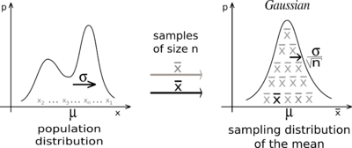
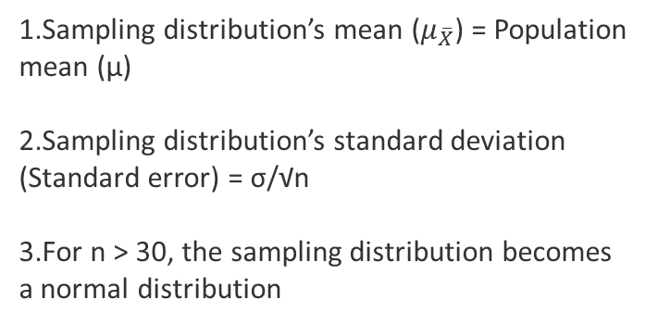
Central Limit Theorem
The central limit theorem says that, for any kind of data, provided a high number of samples has been taken, the following properties hold true:
Sampling distribution’s mean ($μ_{\overline{X}}$) = Population mean (μ)
Sampling distribution’s standard deviation (Standard error) = σ/√n
For n > 30, the sampling distribution becomes a normal distribution

Slide 15
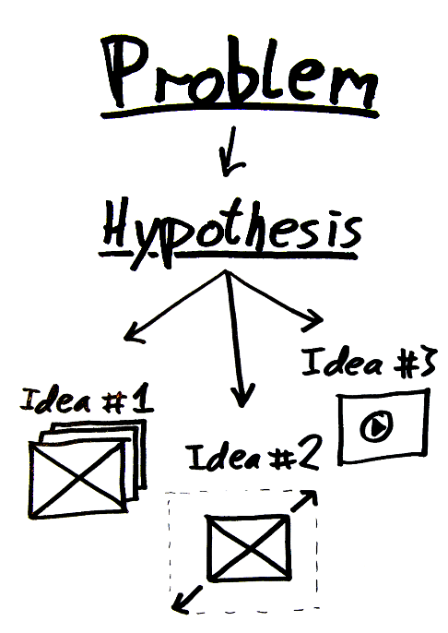
Hypothesis Testing
Hypothesis : a claim or an assumption that we make about one or more population parameters
Types of hypothesis:
Null hypothesis (H₀)
Makes an assumption about the status quo
Always contains the symbols ‘=’, ‘≤’ or ‘≥’
Alternate hypothesis (H₁)
Challenges and complements the null hypothesis
Always contains the symbols ‘≠’, ‘<’ or ‘>’

Slide 16
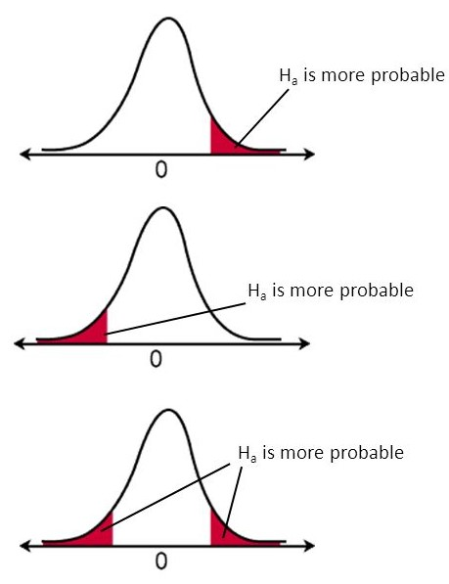
Hypothesis Testing
Types of tests:
Upper-tailed test
The critical region lies on the right side of the distribution
The alternate hypothesis contains the > sign
Lower-tailed test
The critical region lies on the left side of the distribution
The alternate hypothesis contains the < sign
Two-tailed test
The critical region lies on both sides of the distribution
The alternate hypothesis contains the ≠ sign

Slide 17
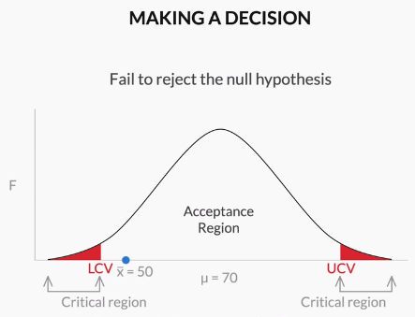
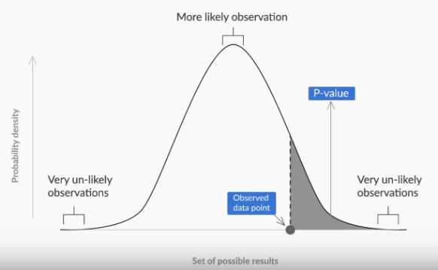
Hypothesis Testing
Making a decision
- Critical value method:
Calculate the value of Zc from the given value of α (significance level)
Calculate the critical values (UCV and LCV) from the value of Zc
Make the decision on the basis of the value of the sample mean ¯x with respect to the critical values (UCV AND LCV)
P-value method:
Calculate the value of z-score for the sample mean point on the distribution
Calculate the p-value from the cumulative probability for the given z-score using the z-table
Make a decision on the basis of the p-value (multiply it by 2 for a two-tailed test) with respect to the given value of α (significance value).

Slide 18

A sample of 40 new baseballs had a bounce height mean of 92.67 inches and a SD of 1.79 inches. Use a .05 sig. level to determine whether there is sufficient evidence to support the claim that the new balls have bounce heights with a mean different from 92.84 inches.

Slide 19

A type I error occurs when the null hypothesis is true but is rejected. A type II error occurs when the null hypothesis is false, but erroneously fails to be rejected.

Slide 20
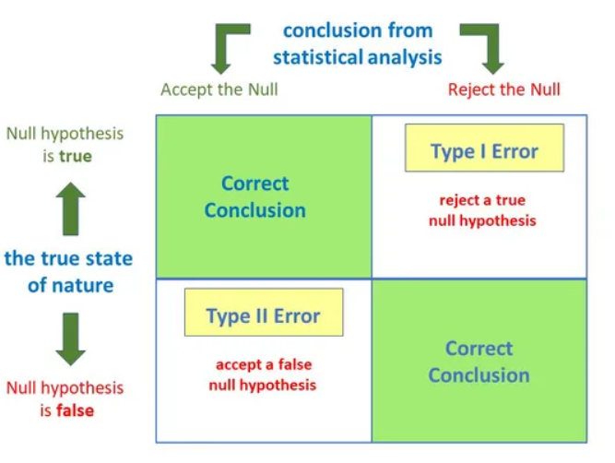
Type I and Type II Error
A type I error occurs when the null hypothesis is true but is rejected.
A type II error occurs when the null hypothesis is false, but erroneously fails to be rejected.

Slide 21

What does P-value signify about the statistical data?

Slide 22
P-value is used to determine the significance of results after a hypothesis test in statistics. P-value helps the readers to draw conclusions and is always between 0 and 1.taking alpha value as 0.05
• P- Value > 0.05 denotes weak evidence against the null hypothesis which means the null hypothesis cannot be rejected.
• P-value <= 0.05 denotes strong evidence against the null hypothesis which means the null hypothesis can be rejected.
• P-value = 0.05 is the marginal value indicating it is possible to go either way.

Slide 23

Suppose we want to test whether boys, on average, score higher than 600 on the SAT verbal section or not.
Suppose we choose our α to be .05. Since this is a one-tailed test, we find our critical value in the upper tail of the sampling distribution, which is z = 1.645. Suppose we also happen to know that the standard deviation for boys SAT verbal section scores is 50.
Now we collect the data using a random sample of 20 Boys and their verbal section scores:
589 633 597 631 639
589 608 638 592 641
645 631 647 607 628
638 603 626 586 608

Slide 24
Determine the null and alternative hypotheses.

Slide 25
This, gives us the hypotheses:
H0 : µ ≤ 600
H1 : µ > 600

Slide 26
Determine the Z – statistic.

Slide 27
z = (618.8 − 600) / (50/√20) = 1.6815

Slide 28
Determine inference based on z-critical

Slide 29
Since 1.6815 > 1.645, we reject the null hypothesis in favor of the alternative explanation that boys score, on average, better than 600 on the verbal section of the SATs

Slide 30

Example :
Did dieters lose more fat than the exercisers?
Diet Only:
sample mean = 5.9 kg, sample standard deviation = 4.1 kg, sample size = n = 42, standard error = SEM1 = 4.1/ √42 = 0.633
Exercise Only:
sample mean = 4.1 kg, sample standard deviation = 3.7 kg, sample size = n = 47, standard error = SEM2 = 3.7/ √47 = 0.540

Slide 31
Determine the null and alternative hypotheses for the provided example.

Slide 32
Null hypothesis: No difference in average fat lost in population
for two methods. Population mean difference is zero.
Alternative hypothesis: There is a difference in average fat lost in
population for two methods. Population mean difference is not zero.

Slide 33
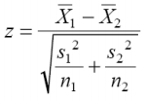
Collect and summarize data into a test statistic (z - statistics)
Hint :
For testing equality of two population means :

Slide 34
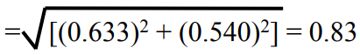
Z = 1.8 / 0.83 = 2.17

Slide 35
Determine the p-value.
You can use the z-table / negative z-table using below webpage
http://www.z-table.com/

Slide 36
The alternative hypothesis was two-sided
p-value = 2 × [proportion of bell-shaped curve 2.17]
proportion is about 2 × 0.015 = 0.03

Slide 37
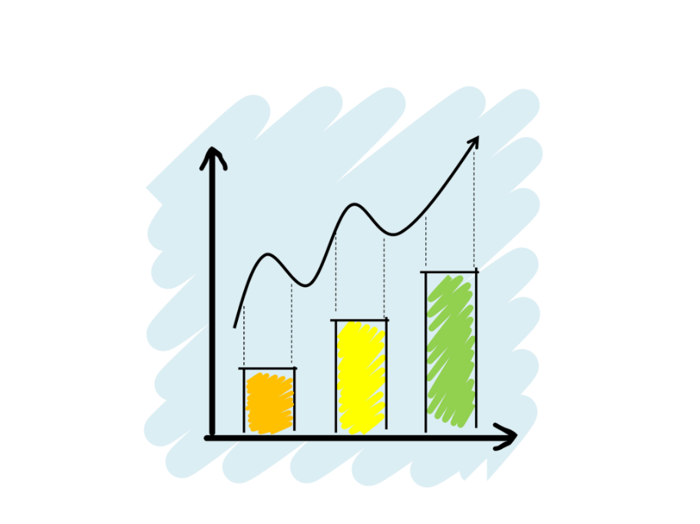
What is Exploratory Data Analysis?
“ Exploratory Data Analysis refers to the critical process of performing initial investigations on data so as to discover patterns, to spot anomalies, to test hypothesis and to check assumptions with the help of summary statistics and graphical representations.”
kinds of data source
Public data: Data collected by the government or other public agencies that are made public for the purposes of research are known as Public data.
Private data: Data generated by Banking, telecom, retail, and media are some of the key private sectors that rely heavily on data to make decisions.
Notes:
It is a good practice to understand the data first and try to gather as many insights from it. EDA is all about making sense of data in hand, before getting them dirty with it.
There are actually no shortcuts for data exploration. If you are in a state of mind, that machine learning can sail you away from every data storm, trust me, it won’t. After some point of time, you’ll realize that you are struggling at improving model’s accuracy. In such situation, only data exploration techniques will come to your rescue.
I can confidently say this, because I’ve been through such situations, a lot. To top all of that Recruiters love EDA ☺

Slide 38
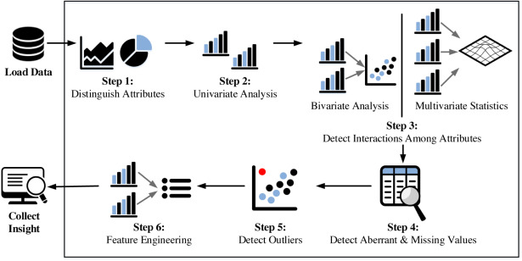
Fundamental steps of EDA process

Slide 39
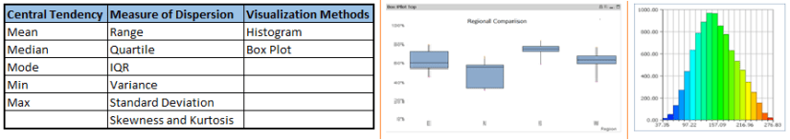
Univariate Analysis
At this stage, we explore variables one by one. Method to perform univariate analysis will depend on whether the variable type is categorical or continuous.

Slide 40
Poll
Please select the plots which could be used for univariate analysis
Histogram
Correlation matrix
Box-plot
Scatter plot
24-10-2020
11

Slide 41
Poll - solution
Please select the plots which could be used for univariate analysis
Histogram
Correlation matrix
Box-plot
Scatter plot
24-10-2020
11

Slide 42
Bi-variate Analysis
Bi-variate Analysis finds out the relationship between two variables. Here, we look for association and disassociation between variables at a pre-defined significance level. We can perform bi-variate analysis for any combination of categorical and continuous variables.
The combination can be:
Categorical & Categorical
Categorical & Continuous
Continuous & Continuous.

Slide 43
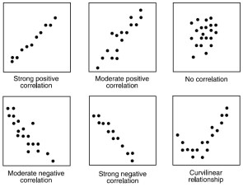
Continuous vs continuous
While doing bi-variate analysis between two continuous variables, we should look at scatter plots. It is a nifty way to find out the relationship between two variables. The pattern of scatter plot indicates the relationship between variables. The relationship can be linear or non-linear.

Slide 44
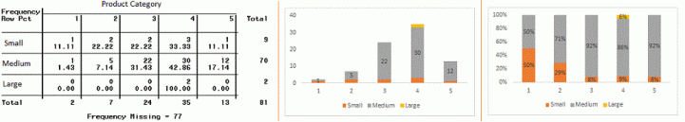
Categorical & Categorical
Two-way table: We can start analyzing the relationship by creating a two-way table of count and count%. The rows represents the category of one variable and the columns represent the categories of the other variable. We show count or count% of observations available in each combination of row and column categories.
Stacked Column Chart: This method is more of a visual form of Two-way table.

Slide 45
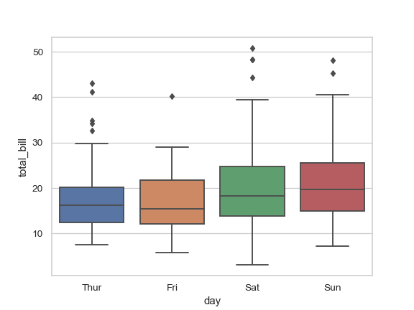
Categorical & continuous
While exploring relation between categorical and continuous variables, we can draw box plots for each level of categorical variables

Slide 46
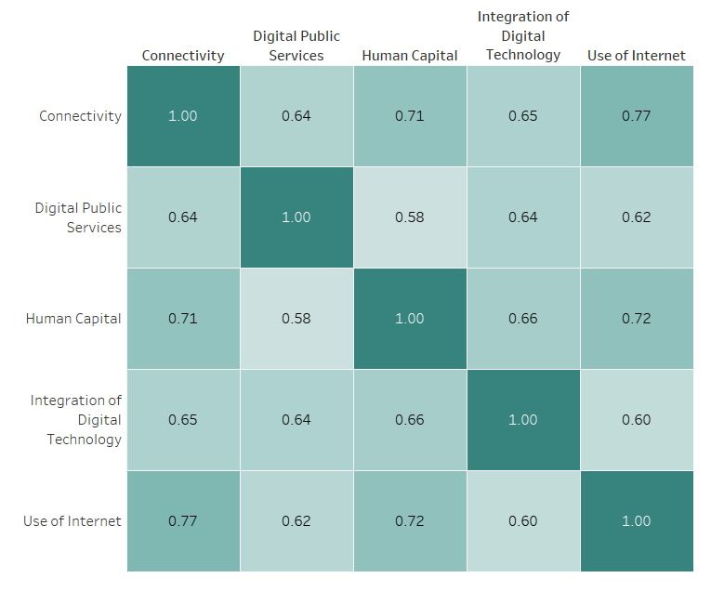
EDA
Poll 1
Please select a category which would lead to highest improvement in “Integration of Digital Technology” category?
Use of internet
Human Capital
Connectivity
Digital public services

Slide 47
EDA
Poll 1 (Answer)
Please select a category which would lead to highest improvement in “Integration of Digital Technology” category?
Use of internet
Human Capital
Connectivity
Digital public services

Slide 48
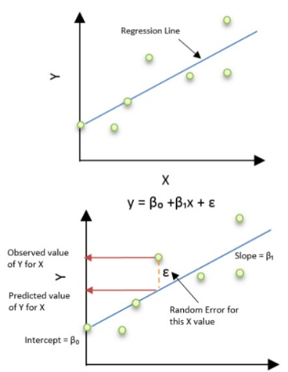
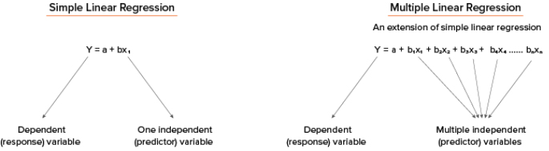
Linear Regression
What Is Linear Regression?
It is the simplest form of regression. It is a technique in which the dependent variable is continuous in nature. The relationship between the dependent variable and independent variables is assumed to be linear in nature.
Simple linear regression, gets its adjective ‘simple’, because it concerns the study of only one predictor variable, similarly multiple linear regression concerns the study of two or more predictor variables.

Slide 49
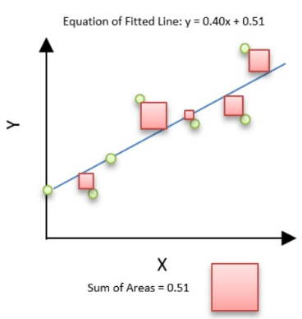
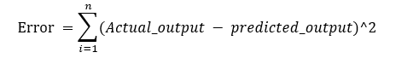
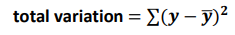
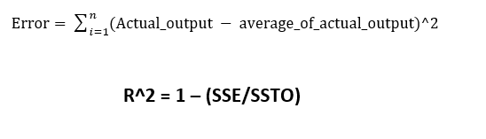
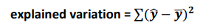
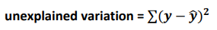
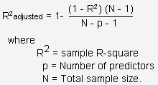
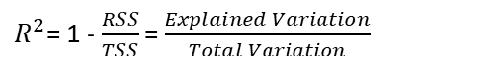
Linear Regression
Residual sum of squares (RSS)
This gives information about how much the target value varies around the regression line (predicted value).
The best-fit line is obtained by minimizing a quantity called Residual Sum of Squares (RSS) which could be optimized using Gradient Descent to get parameters of the best fit line.
Total sum of squares (TSS)
This tells how much the data point move around the mean.
R-squared is a statistical measure of how close the data are to the fitted regression line. It is also known as the coefficient of determination
$R^{2}$= 1 - $\frac{RSS}{TSS}$ = $\frac{Explained Variation}{Total Variation}$

Slide 50
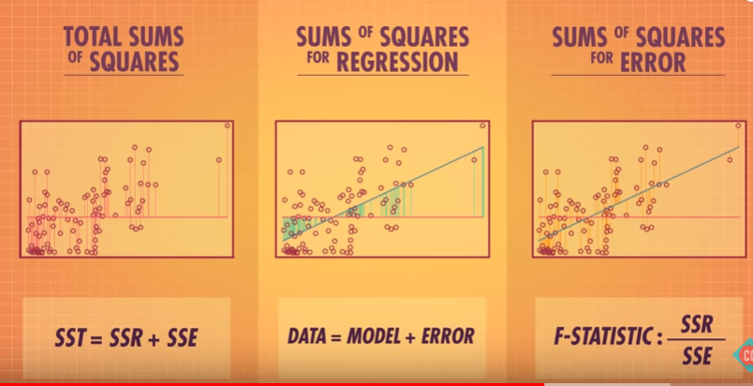

Poll 1
Which of the figures best represent RSS & TSS respectively?
(1)
(2)
(3)
Practice in teams of 4 students
Industry expert mentoring to learn better
Get personalised feedback for improvements
1 & 2
2 & 3
1 & 3
3 & 1
24-10-2020
11

Slide 51
Poll 1(Answer)
Which of the figures best represent RSS & TSS respectively?
(1)
(2)
(3)
Practice in teams of 4 students
Industry expert mentoring to learn better
Get personalised feedback for improvements
1 & 2
2 & 3
1 & 3
3 & 1
24-10-2020
12

Slide 52
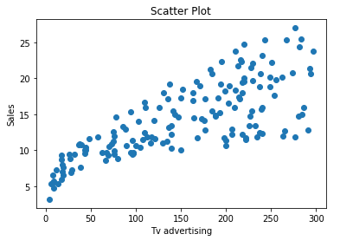
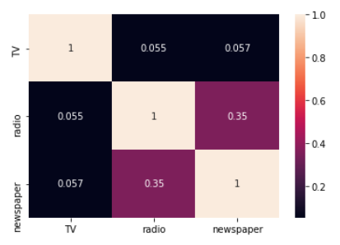
Assumptions of Linear Regression
Linear Relationship between the features and target
According to this assumption there is linear relationship between the features and target. Linear regression captures only linear relationship. This can be validated by plotting a scatter plot between the features and the target.
Little or no Multicollinearity between the features
Multicollinearity is a state of very high inter-correlations or inter-associations among the independent variables. It is therefore a type of disturbance in the data if present weakens the statistical power of the regression model. Pair plots and heat maps(correlation matrix) can be used for identifying highly correlated features.
http://people.duke.edu/~rnau/testing.htm
https://www.analyticsvidhya.com/blog/2016/07/deeper-regression-analysis-assumptions-plots-solutions/

Slide 53
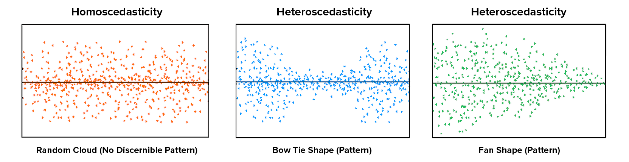
Assumptions of Linear Regression
Homoscedasticity Assumption
Homoscedasticity describes a situation in which the error term (that is, the “noise” or random disturbance in the relationship between the features and the target) is the same across all values of the independent variables
Notes:
The leftmost graph shows no definite pattern i.e constant variance among the residuals,the middle graph shows a specific pattern where the error increases and then decreases with the predicted values violating the constant variance rule and the rightmost graph also exhibits a specific pattern where the error decreases with the predicted values depicting heteroscedasticity

Slide 54
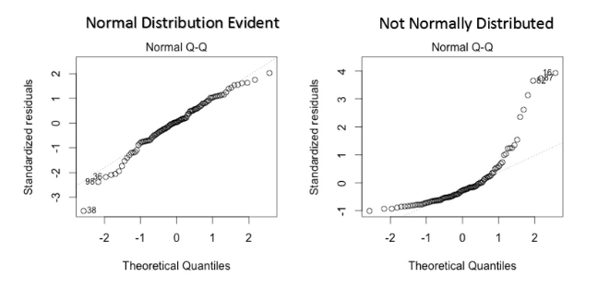
Assumptions of Linear Regression
Error terms are normally distributed with mean zero
The fourth assumption is that the error(residuals) follow a normal distribution. One particular repercussion of the error terms not being normally distributed is that the p-values obtained during the hypothesis test to determine the significance of the coefficients become unreliable.
Normal distribution of the residuals can be validated by plotting a q-q plot.
Notes:
However, a less widely known fact is that, as sample sizes increase, the normality assumption for the residuals is not needed. More precisely, if we consider repeated sampling from our population, for large sample sizes, the distribution (across repeated samples) of the ordinary least squares estimates of the regression coefficients follow a normal distribution. As a consequence, for moderate to large sample sizes, non-normality of residuals should not adversely affect the usual inferential procedures. This result is a consequence of an extremely important result in statistics, known as the central limit theorem.

Slide 55
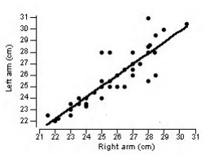
Polls
Q . In a simple linear regression model (One independent variable), If we change the input variable by 1 unit. How much output variable will change?
by 1
no change
by intercept
by its slope
The following scatterplot shows the relationship between the left and right forearm lengths (cm) for 55
college students along with the regression line, where y =left forearm length x = right forearm length.
Q . Which of the following linear equation is correct?
Ŷ = 1.22 + 0.95x
Ŷ = 1.22 - 0.95x
Ẍ = 1.22 + 0.95y
Ẍ = 1.22 - 0.95y

Slide 56
Polls
Q. One of the four choices is the value of the correlation for this situation. The correlation is
–0.88
0.00
0.88
1.00
Q. The proportion of total variation explained by x, R2 , is closest to
–78.3%
0.0%
78.3%
100.0%

Slide 57

Difference between linear & logistic regression

Slide 58
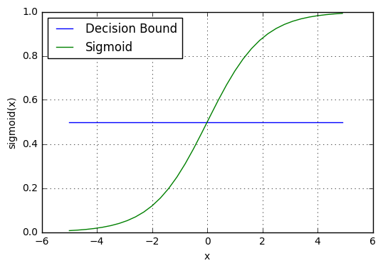
Logistic regression
What is logistic regression?
Logistic regression is a classification algorithm used to assign observations to a discrete set of classes. Unlike linear regression which outputs continuous number values, logistic regression transforms its output using the logistic sigmoid function to return a probability value which can then be mapped to two or more discrete classes.

Slide 59
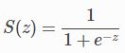
Logistic regression
Sigmoid activation
In order to map predicted values to probabilities, we use the sigmoid function. The function maps any real value into another value between 0 and 1. In machine learning, we use sigmoid to map predictions to probabilities.
Decision boundary
Our current prediction function returns a probability score between 0 and 1. In order to map this to a discrete class (true/false, cat/dog), we select a threshold value or tipping point above which we will classify values into class 1 and below which we classify values into class 2.
p≥0.5,class=1
p<0.5,class=0

Slide 60
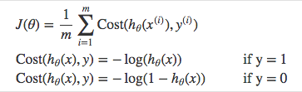
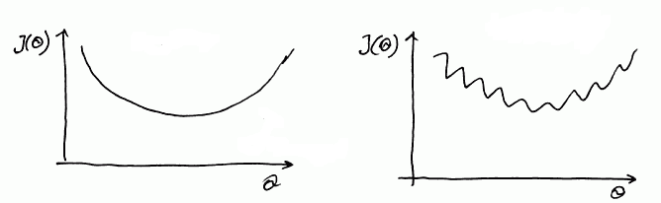
Logistic regression
Cost function
But we shouldn’t use the same cost function MSE as we did for linear regression.
Why? You can refer to chapter 3 of Michael Neilson’s deep learning book for the complete explanation.
For now
it’s because our prediction function is non-linear Squaring this prediction as we do in MSE results in a non-convex function with many local minimums.
If our cost function has many local minimums, gradient descent may not find the optimal global minimum.
Convex
Non - Convex

Slide 61
Polls
Suppose that seven out of 10 males are admitted to an engineering school while three of 10 females are
admitted.
Q. The odds for admitting a male are:
2.5
2.3
0.48
Q. The odds for admitting a female are:
2.5
2.3
0.42
Q. What is the odds ratio for admission?
2.5
5.4
4.8

Slide 62
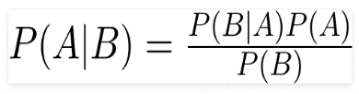
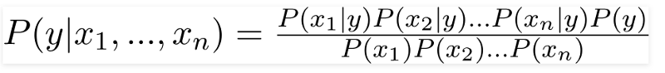
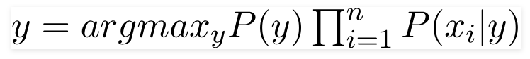
Naive Bayes
What is Naive Bayes?
A Naive Bayes classifier is a probabilistic machine learning model that is based on the Bayes theorem
Bayes Theorem
Using Bayes theorem, we can find the probability of A happening, given that B has occurred. Here, B is the evidence and A is the hypothesis. The assumption made here is that the predictors/features are independent. That is presence of one particular feature does not affect the other. Hence it is called naive.
There could be cases where the classification could be multiclass. Therefore, we need to find the class y with maximum probability.
Naive Bayes algorithms are mostly used in sentiment analysis, spam filtering, recommendation systems etc. They are fast and easy to implement but their biggest disadvantage is that the requirement of predictors to be independent. In most of the real life cases, the predictors are dependent, this hinders the performance of the classifier.

Slide 63
Why is “Naive” Bayes naive?

Slide 64

Despite its practical applications, especially in text mining, Naive Bayes is considered “Naive” because it makes an assumption that is virtually impossible to see in real-life data: the conditional probability is calculated as the pure product of the individual probabilities of components. This implies the absolute independence of features — a condition probably never met in real life.
Example : a Naive Bayes classifier that figured out that you liked pickles and ice cream would probably naively recommend you a pickle ice cream.

Slide 65
What is Bias Variance Tradeoff ?

Slide 66
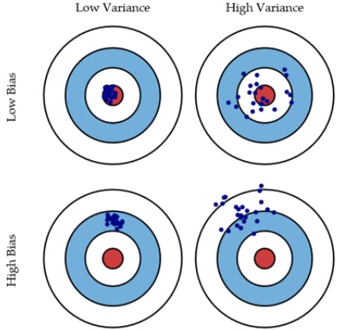
Bias and Variance in regression models
The prediction error for any machine learning algorithm can be broken down into three parts:
Bias Error
Variance Error
Irreducible Error
The irreducible error cannot be reduced regardless of what algorithm is used. It is the error introduced from the chosen framing of the problem and may be caused by factors like unknown variables that influence the mapping of the input variables to the output variable.
Low Bias: Suggests less assumptions about the form of the target function.
High-Bias: Suggests more assumptions about the form of the target function.
Low Variance: Suggests small changes to the estimate of the target function with changes to the training dataset.
High Variance: Suggests large changes to the estimate of the target function with changes to the training dataset.

Slide 67
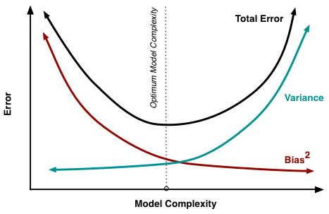
Bias-Variance Trade-Off
The goal of any supervised machine learning algorithm is to achieve low bias and low variance. In turn the algorithm should achieve good prediction performance.
Parametric or linear machine learning algorithms often have a high bias but a low variance.
Non-parametric or non-linear machine learning algorithms often have a low bias but a high variance.
The parameterization of machine learning algorithms is often a battle to balance out bias and variance.

Slide 68
Model Evaluation
A confusion matrix shows the number of correct and incorrect predictions made by the classification model compared to the actual outcomes (target value) in the data. The matrix is NxN, where N is the number of target values (classes). Performance of such models is commonly evaluated using the data in the matrix. The following table displays a 2x2 confusion matrix for two classes (Positive and Negative).
Confusion Matrix | Target
 | Positive | Negative
Positive | a | b | Positive Predictive Value | a/(a+b)
Negative | c | d | Negative Predictive Value | d/(c+d)
 | Sensitivity | Specificity | Accuracy = (a+d)/(a+b+c+d)
Accuracy : the proportion of the total number of predictions that were correct.
Positive Predictive Value or Precision : the proportion of positive cases that were correctly identified.
Negative Predictive Value : the proportion of negative cases that were correctly identified.
Sensitivity or Recall : the proportion of actual positive cases which are correctly identified.
Specificity : the proportion of actual negative cases which are correctly identified.

Slide 69
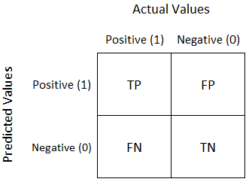
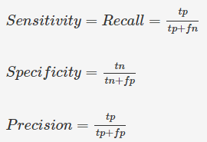
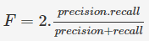
LOGISTIC REGRESSION
A confusion matrix shows the number of correct and incorrect predictions made by the classification model compared to the actual outcomes (target value) in the data.

Slide 70
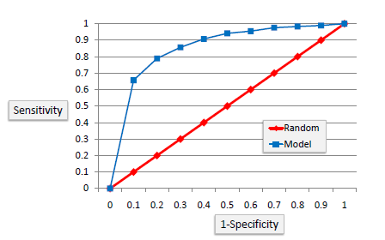
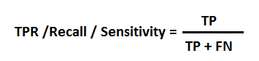

Model Evaluation
ROC Curves summarize the trade-off between the true positive rate and false positive rate for a predictive model using different probability thresholds
It’s often used as a proxy for the trade-off between the sensitivity of the model (true positives) vs the fall-out or the probability it will trigger a false alarm (false positives).

Slide 71

#LifeKoKaroLift
Thank You!
References :
https://www.superprof.co.uk/resources/academic/maths
https://www.superprof.co.uk/resources/academic/maths
http://users.stat.ufl.edu/
https://www.surveygizmo.com/resources
https://courses.lumenlearning.com/introstats1/chapter/null-and-alternative-hypotheses/
https://www.ck12.org/book/CK-12-Advanced-Probability-and-Statistics-Concepts/
https://www.indiabix.com/data-interpretation

